Slide 1
CARGO MANAGEMENT SYSTEM

Slide 2
ABSTRACT
The project entitled as “CARGO MANAGEMENT SYSTEM” is a supply chain management component that is used to meet customer demands through planning, control and implementation of the effective movement and storage of related information, goods and services from origin to destination. Cargos service providers face many problems when they do work manually. Some of the drawbacks are customer services become inefficient, transportation cost may increase. Hence, cargo management system application solves all the entire problem and provides many features like, warehouse management, fleet management, processing orders, inventory control and order tracking. The project contains two type of interaction like Admin and Customer. Admin has authority to add or remove goods in the system and also maintain records of the goods available in the warehouse. The admin will update the goods details if required. Whereas the customer can book the cargo by entering source and destination place. The main advantages of the system are it excludes the use of paper work by managing all the records electronically. The administrator need not keep a manual track of the goods and can keep updating the system by filling in the details of the new goods arrived in warehouses and their availability. Hence it saves the human efforts and resources.

Slide 3
HARDWARE SPECFICATION
Processor : P 4 700 GHz.
RAM : 4 GB RAM
Hard Disk Drive : 180 GB

Slide 4
SOFTWARE SPECIFICATION
Operating System : Windows 7/8/10
Front End : JAVA
Back End : SQL

Slide 5
EXISTING SYSTEM
In existing system there will be order form (or) letter which is registered or updated by the employee of an Organization. The customer has to visit the office whenever they have any booking regarding the services, which is time consuming process. The registered booking may be forwarded to the workers in the specified department.
Drawbacks of Existing System
The following are the drawbacks of the existing system
In Cargo management system, the process is done manually.
Due to that they face problems like data loss.
It consumes more time to process the bookings.
The customer does not know current location of the product.

Slide 6
PROPOSED SYSTEM
Previously, In Cargo Management system they were done manual. Now developed the site to make the things computerized. The customer can submit the orders through the website. The submitted orders are assigned to the workers for further action. The orders can be tracked by the users. The system is a web enabled centralized information and management application to meet customer requirements in building best relations with its public community by providing fast mechanism to the customer grievances. The website will collect more information from the user and give a better view to the booking of cargoes.
Advantages of Proposed System
Data is maintained in a structured format.
Reliable Customer Order Process.
User can view the location of orders.

Slide 7
Modules
Admin Login
This module is an managing the software, admin having an responsibility to perform the software. Here only one user can be using this application. We can refer the admin table and validating the username and password and perform into the login
Customer Registration
This module collects all the information about the customer like name, mobile number and address details etc.… these details has been stored into the customer details. When we need to collect the customer details can get here.

Slide 8
Ship Registration
Admin register the shipping details and register the ship, once ship has been registered can make an order under the ship. This is an main module for this software. Which contains shipping details also
Order Registration
After the customer registration admin can able to register an order, this will collect all the information about the order details. Which collect the order product name, branch, from, to and weight also.
Order Details
This module shown the order details in this order details tab. We can see the order current status as well, also able to display the amount of the order.

Slide 9

Data Flow Diagram
Level 0:

Slide 10
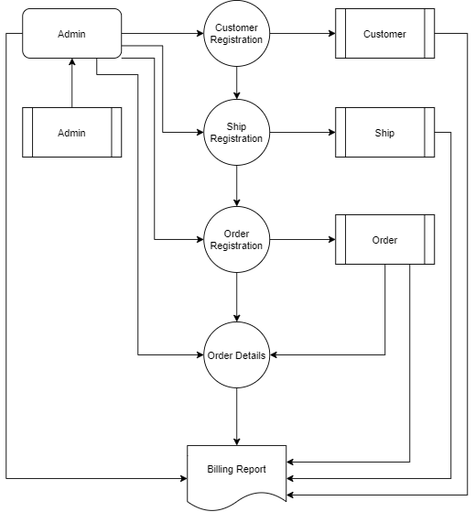
Level 1:

Slide 11
TABLE NAME: ADMIN
FIELD NAME | FIELD TYPE | SIZE | CONSTRAINT
admin_id | Int | 10 | Primary key
Name | Varchar | 25 | Not null
Email | Varchar | 25 | Not null
Phone | Int | 10 | Not null
Address | Varchar | 25 | Not null
Zip_code | Int | 6 | Not null
Username | Varchar | 25 | Not null
Password | Varchar | 12 | Not null

Slide 12
TABLE NAME: SHIP
FIELD NAME | FIELD TYPE | SIZE | CONSTRAINT
Ship Id | Int | 10 | Primary key
Vehicle_number | Varchar | 12 | Not null
Vehicle_type | Varchar | 15 | Not null
Vehicle_model | Varchar | 15 | Not null

Slide 13
TABLE NAME: ORDER
FIELD NAME | FIELD TYPE | SIZE | CONSTRAINT
Order id | Int | 10 | Primary key
Name | Varchar | 20 | Not null
Address | Varchar | 25 | Not null
Pickupdate | Date | 10 | Not null
Deliverydate | Date | 10 | Not null
Weight | Number | 25 | Not null
Packing_type | Varchar | 25 | Not null
Company_name | Varchar | 20 | Not null
Company_address | Varchar | 25 | Not null
Mobile_number | Number | 12 | Not null
Picklocation | Varchar | 15 | Not null
Droplocation | Varchar | 15 | Not null
Customer_id | Int | 10 | Foreign key

Slide 14
TABLE NAME: CUSTOMER
FIELD NAME | FIELD TYPE | SIZE | CONSTRAINT
Customer id | Int | 10 | Primary key
Name | Varchar | 25 | Not null
Email | Varchar | 25 | Not null
Phone | Int | 10 | Not null
Address | Varchar | 25 | Not null
Zip_code | Int | 6 | Not null

Slide 15
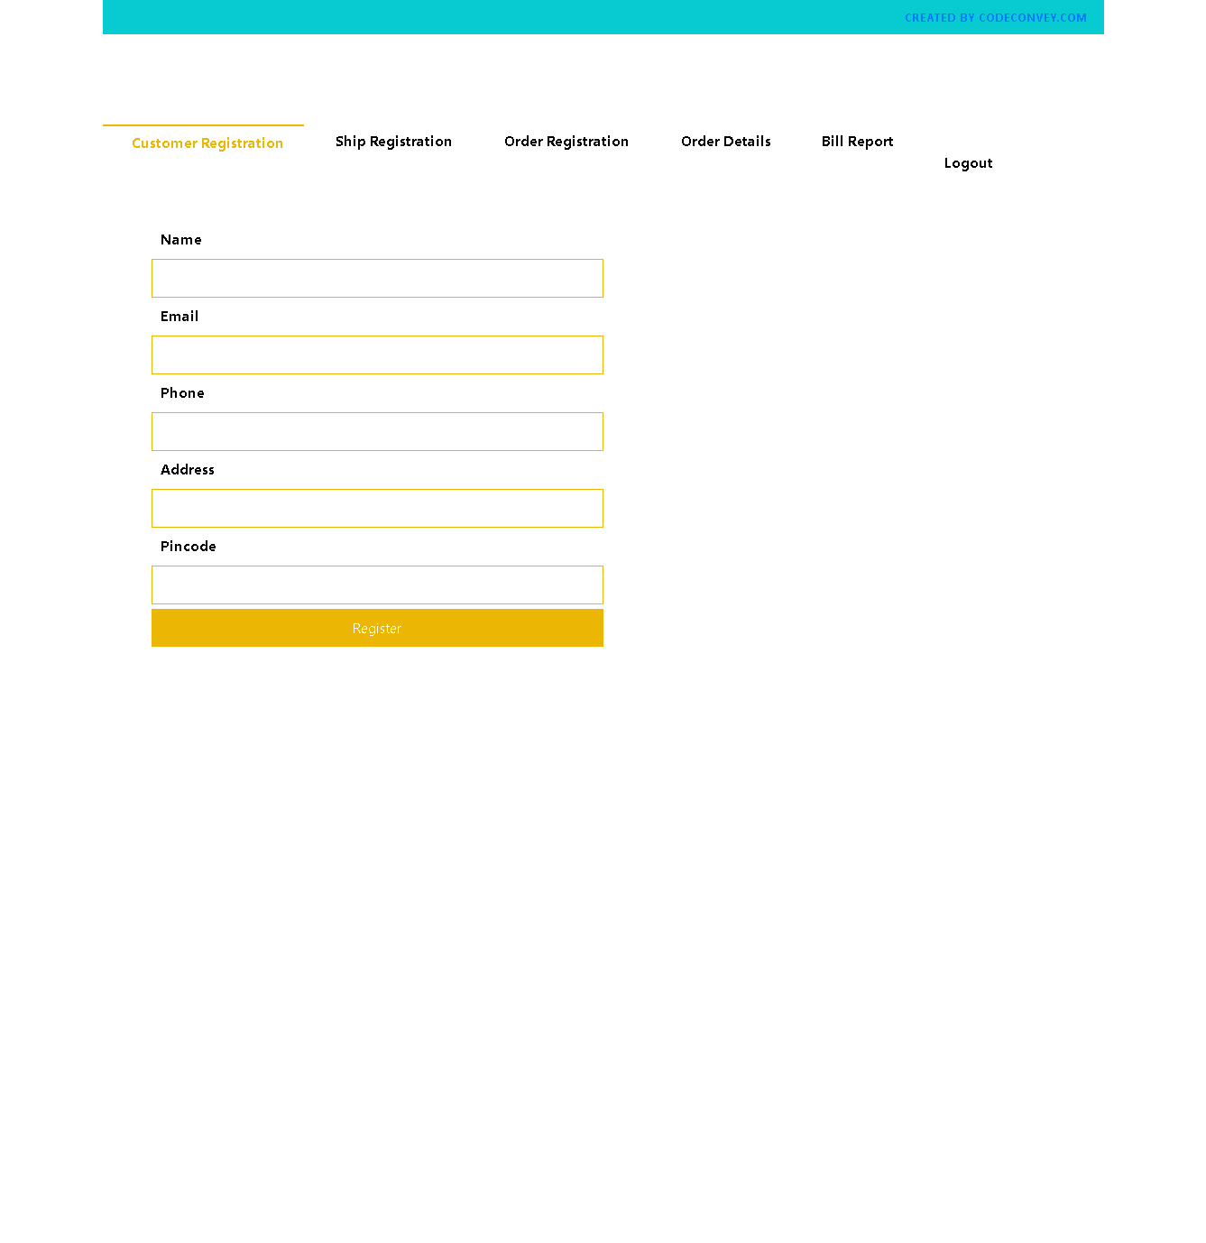

Slide 16
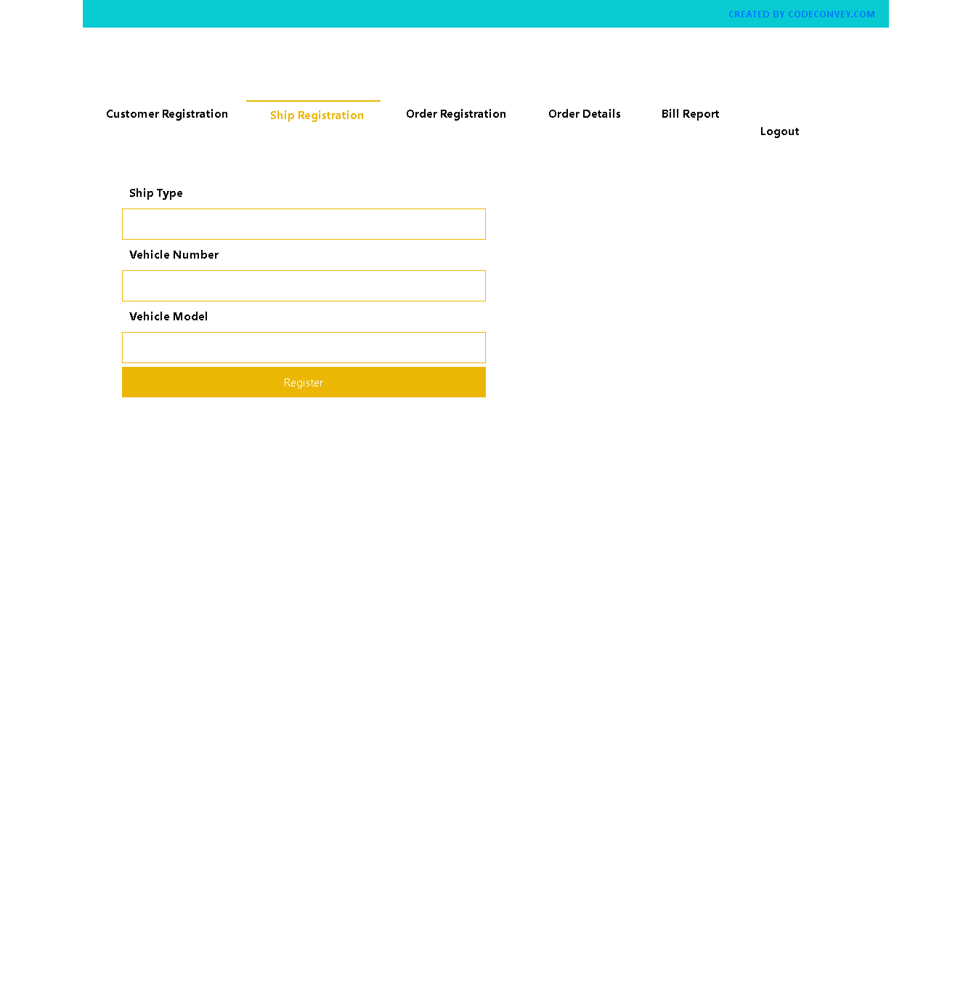

Slide 17
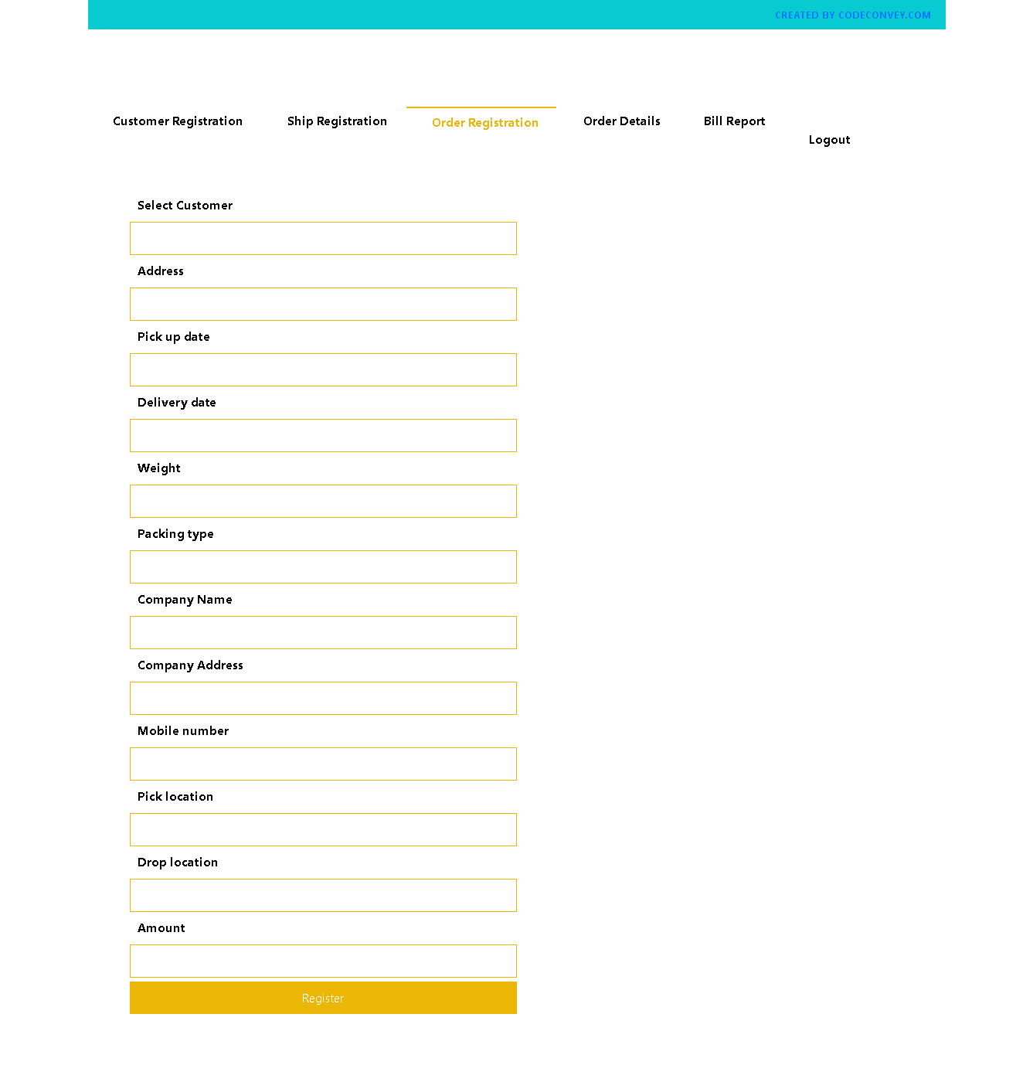

Slide 18
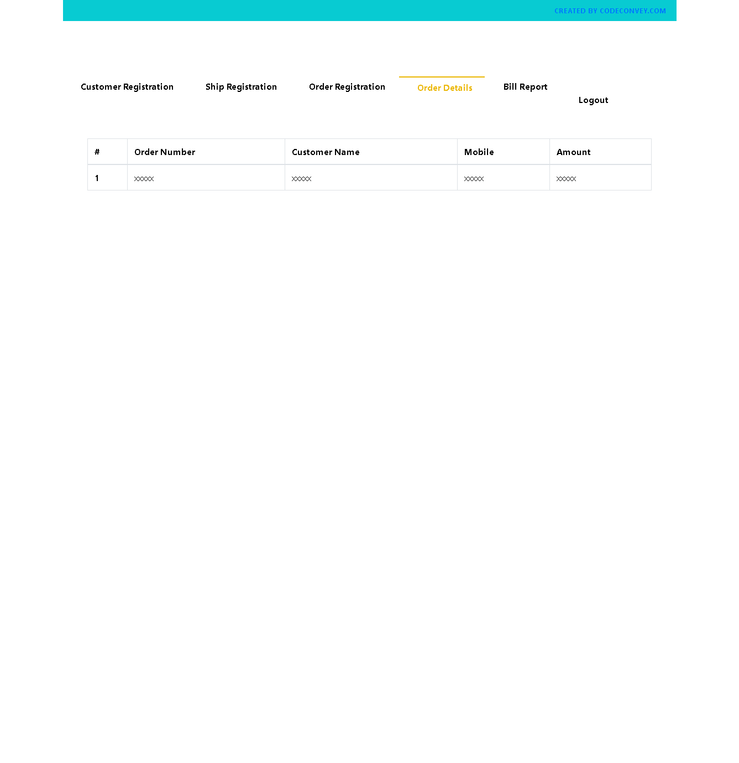

Slide 19
Thank You

